Slide 1
Troubles on the Bus

Slide 2
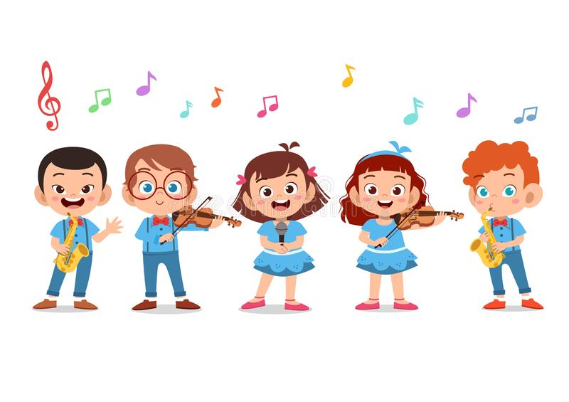
Today’s Plans
First, we will watch videos about behaviors on the bus
Second, we will talk about what we can do when there are troubles on the bus
Third, we will do a small activity if we have the time

Slide 3
Expected behaviors on the bus
https://youtu.be/Cj7XtCtqO1k (3:30)

Slide 4
Unexpected behaviors on the bus
https://youtu.be/Cj7XtCtqO1k (0:42)

Slide 5
When someone hits/bugs you on the bus
Who can you talk to?

Slide 6
Your teachers

Slide 7
Your parents

Slide 8
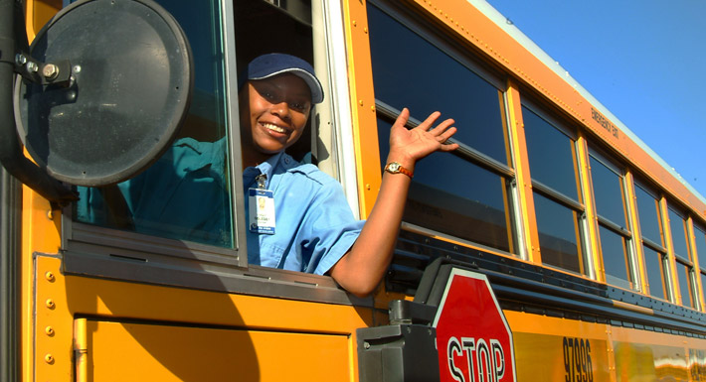
The bus driver

Slide 9
How do you tell?

Slide 10
Let’s practice!

Slide 11
Let’s practice!

Slide 12
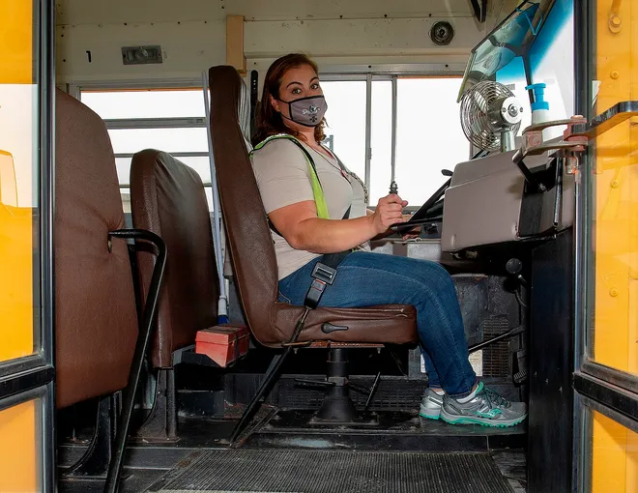
Let’s practice!

Slide 13
Size of the problem
1 2 3 4 5 6 7 8 9 10
Small problem Big problem

Slide 14
We can also tell the person to stop
https://youtu.be/k-6ws8LZECU (2:41-4:45) (7:17-8:00)

Slide 15
Let’s practice!

Slide 16
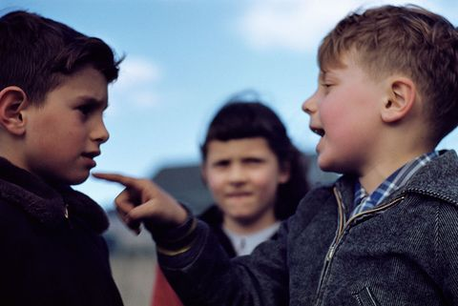
Let’s practice!

Slide 17
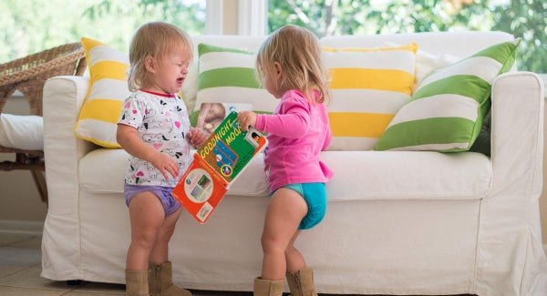
Let’s practice!

Slide 18
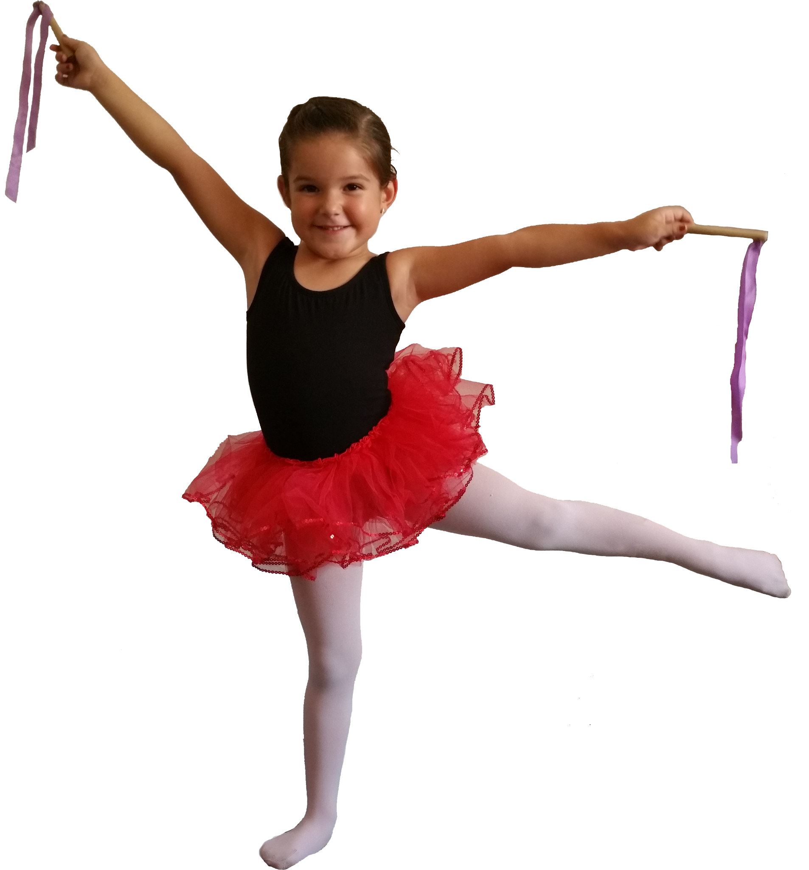
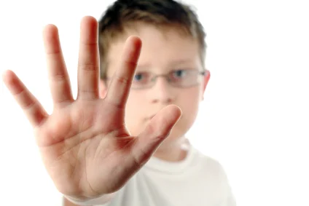
Stop when others say “Stop!”
https://youtu.be/RoYxG0avSfY
1 dance leader 1 student to say “Stop!”

